Slide 1


Department of Computer Science and Engineering
MACHINE LEARNING TECHNIQUES FOR
ACCELERATED DIAGNOSIS AND
CLASSIFICATION OF ASH GOURD LEAF
DISEASES
Mr.Deepak Kumar K
Assistant Professor
B21A2425C02
Lathika P - 210701131
Madhumitha S - 210701142

Slide 2
Problem Statement and Motivation
Plant diseases are a critical issue in agriculture, leading to significant crop losses and reduced food quality. Traditional detection methods, which rely on manual inspection, are time-consuming, labor-intensive, and prone to error. These challenges hinder timely and accurate identification of diseases, leading to delayed interventions and, in many cases, the unnecessary use of harmful pesticides. There is a growing need for an automated, efficient, and accurate solution to detect plant diseases in real-time.
With global food demand on the rise, improving agricultural productivity is essential. Machine learning, particularly through advanced models like Vision Transformers (ViTs) and Convolutional Neural Networks (CNNs), offers a promising solution to the limitations of traditional plant disease detection. By automating the process, this project aims to provide farmers with a tool that ensures early, accurate disease identification, leading to timely interventions, reduced crop losses, and more sustainable agricultural practices.

Slide 3
Objectives
Accurate and efficient diagnosis using advanced machine learning algorithms and image processing
Decrease time for detection and to focus on the further process.
Image processing to extract the important features.
Improve the performance of the machine learning algorithm to effectively detect the diseases.

Slide 4
Abstract
This project focuses on detecting and classifying leaf diseases in Ash Gourd using advanced machine learning techniques. The dataset, sourced from Kaggle, contains images of healthy leaves and diseased categories such as K, K_mg, N, powdery mildew, N_K, and N_mg. The methodology involves several critical stages: preprocessing the data to enhance quality, applying data augmentation techniques to increase dataset diversity, and segmenting the data for training and testing phases. DeepLabV3+ with a ResNet backbone is employed for precise segmentation and classification. To ensure robust performance, accuracy is meticulously monitored, and early stopping callbacks are implemented during epochs to mitigate overfitting. This approach aims to accelerate diagnosis, improve classification accuracy, and contribute to effective disease management in agriculture.

Slide 5
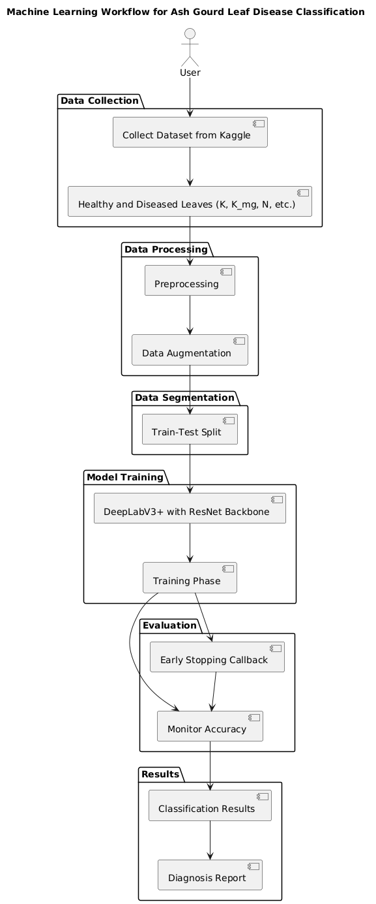
System Architecture

Slide 6
List of Modules
Data Collection
Data preprocessing
Data augmentation
Segmentation
Classification using variants of CNN algorithm

Slide 7
Functional Description
Data Collection: The collection of precise as well as valid data is essential for model's training in order to get the highest level of classification accuracy that makes the model more credible. This study uses the publicly accessible data set in which Ashgourd images can be found. After collecting data, preliminary processing is carried out to transform the images to a form which the model may accept as input.Data is first divided into four folders illustrating four classes: Healthy, potassium, Magnesium, Nitrogen and combined deficiencies which causes diseases respectively. Afterwards, data is separated into train and test data with a proportion of 80:20.

Slide 8
Functional Description
Data Augmentation: A range of data augmentation procedures were utilized to decrease overfitting by increasing the training dataset's effective size and improve our model's generalizability. Among the augmentation techniques were random rotations to mimic different orientations, flipping (horizontally and vertically) to account for mirrored or inverted scans, and scaling to introduce variation in the size of regions of interest.

Slide 9
Functional Description
Segmentation:DeepLab v3: This architecture leverages a powerful encoder-decoder structure for segmentation tasks, making it highly suitable for identifying and classifying Ashgourd leaf diseases. Unlike traditional classification models, DeepLab v3 generates precise pixel-level segmentations of diseased areas in leaves, enhancing localization and disease characterization.
The encoder employs layers to capture multi-scale contextual information without losing spatial resolution, supported by an effective module. The feature-rich encoder output is then refined and upsampled through the decoder network, ensuring high-resolution predictions while reducing the computational burden and improving model performance for Ashgourd leaf disease detection.

Slide 10
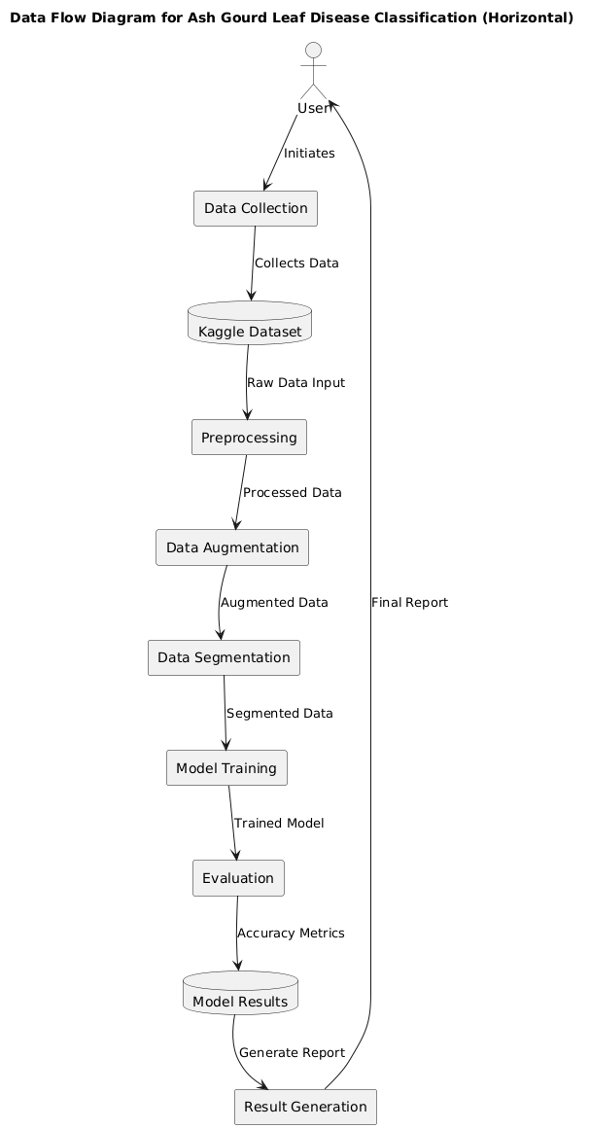
DFD Diagram

Slide 11
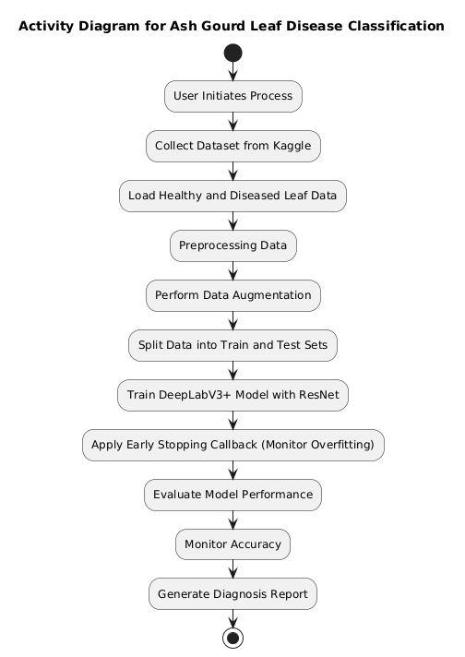
Activity Diagram

Slide 12
Implementation & Results of First Module
TensorFlow and Keras were used for data augmentation using numpy was used to check for disparities in classes in the data cleaning.
Segmentation was done using DeepLabv3 with resnet as backbone.

Slide 13
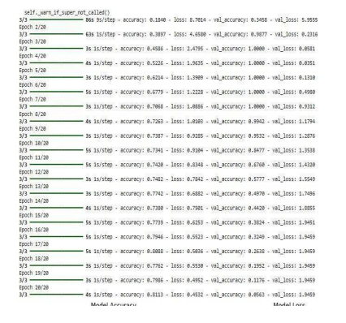
Implementation & Results of First Module
Training Loss and Epochs

Slide 14
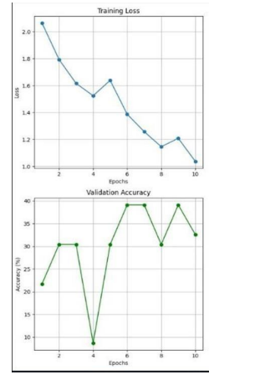
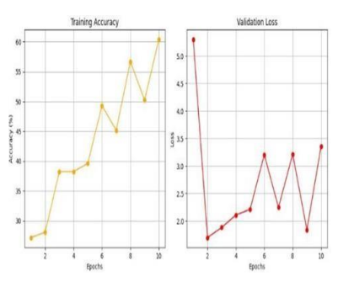
Implementation & Results of First Module
Accuracy and Validation loss

Slide 15
Conclusion & Work for Phase II
For the core segmentation task, DeepLab v3 was used to accurately segment the Ashgourd leaf images, focusing on identifying disease-affected regions. This approach provided precise delineation of features critical for disease diagnosis and analysis. Performance metrics, including accuracy, precision, recall, and F1 score, were used to assess the effectiveness of DeepLab v3 in identifying and segmenting different types of Ashgourd leaf diseases, such as KMg, K, N, and Nmg powdery mildew, as well as healthy leaf samples.

Slide 16
Conclusion & Work for Phase II
Input Preparation: The segmented images from DeepLab v3 serve as inputs for ViTs, ensuring that only relevant areas (disease-affected regions) are processed, reducing noise and improving focus.
Transformer Encoding: The input patches undergo linear embedding before being fed into multiple self-attention layers, capturing both local and global features relevant to disease type and severity.
Classification Output: The final output layer maps the extracted features to specific disease categories, enabling accurate disease diagnosis and differentiation among the identified classes.

Slide 17
References
Zhang, S., Huang, W., & Zhang, C. (2020). "Plant ailment acknowledgment based on plant leaf figure study." Applied Brilliance, 50(9), 3449–3462.
Mohanty, S. P., Hughes, Individual forced to leave his or her native country or home, & Salathé, M. (2016). "Using deep knowledge for figure-located plant disease discovery." Boundaries in Plant Science, 7, 1419.
Sladojevic, S., Arsenovic, M., Anderla, A., Culibrk, D., & Stefanovic, D. (2016). "Deep affecting animate nerve organs networks located acknowledgment of plant diseases by leaf countenance categorization." Computational Intelligence and Neuroscience, 2016.
Ferentinos, K. P. (2018). "Deep education models for plant affliction detection and disease." Calculatings and Televisions in Agriculture, 145, 311-318.
Picon, A., Alvarez-Gila, A., Seitz, M., Ortiz- Barredo, A., & Echazarra, J. (2019). "Deep convolutional affecting animate nerve organs networks for travelling capture device-located crop ailment categorization in the wild." Calculatings and VCRs in Agriculture, 161, 280–290

Slide 18
References
Also, E. C., Yujian, L., Njuki, S., & Yingchun, L. (2019). "A approximate study of fine-tuning deep knowledge models for plant affliction labeling." Computers and Camcorders in Farming, 161, 272– 279.
Brahimi, M., Boukhalfa, K., & Moussaoui, A. (2017). "Deep learning for attractive woman afflictions: Categorization and symptoms imagination." Used Artificial Intelligence, 31(4), 299–315.
Kamilaris, A., & Prenafeta-Boldú, F. X. (2018). "Deep education in farming: A survey." Computers and Camcorders in Farming, 147, 70–90.
Lu, Y., Yi, S., Zeng, N., Liu, Y., & Zhang, Y. (2017). "Labeling of rice ailments utilizing deep convolutional neural networks." Neurocomputing, 267, 378–384.
Wang, G., Star, Y., & Wang, J. (2017). "Mechanical representation-based plant ailment asperity estimation utilizing deep education." Computational Intelligence and Neuroscience, 2017. [11] Fuentes, A., Yoon, S., Kim, S. C., & Park, D. S. (2017). "

Slide 19
Paper Publication Status
Accepted for publication

Slide 20
Thank You

